Slide 1

Insurance Analysis

Slide 2
GROUP 5
1)Yogita Patil
2)Manisha Chaudhary
3)Enugala Jayakrishna
4)Milind Gaikwad

Slide 3
Project Overview
Objective:
To provide a comprehensive view of the insurance business performance across various selling channels (Cross Sell, New Sell, Renewal), highlighting achievements, invoices, and opportunity metrics
Data Sources:
CRM system for opportunities and meetings
Finance systems for budget and invoice tracking
Product portfolio records

Slide 4
Project Overview
Tools Used:
Excel
Power BI
Tableau (based on layout styling)
SQL
Outcome:
The dashboards enables data-driven decisions by visualizing sales performance, identifying bottlenecks, and unlocking growth opportunities within the insurance sales pipeline.

Slide 5
Agenda
01
.
Analyse performance against set sales targets
Monitor invoice generation and budget utilization
02
Evaluate opportunity distribution by product and revenue
03
Track performance, meetings and activities of account executives

Slide 6
Actionable Insights
Focus on boosting New Sell conversions
Improve invoice realization for Cross and New Sell
Leverage successful Renewal strategies across other categories
Prioritize high-value opportunities (top 4)

Slide 7
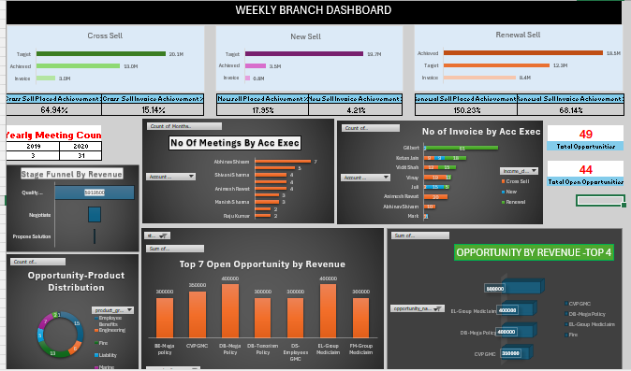
Excel Dashboard-Weekly Branch Dashboard

Slide 8
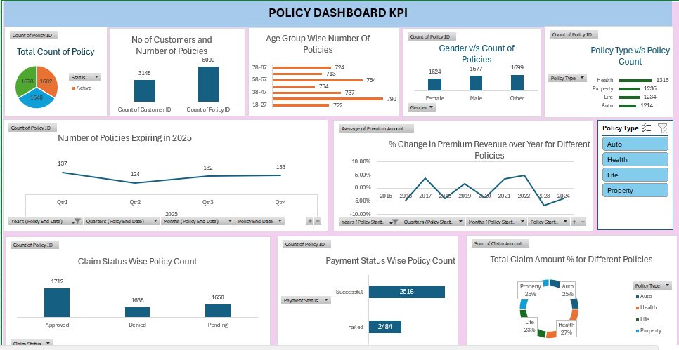
Excel Dashboard- Policy Data

Slide 9
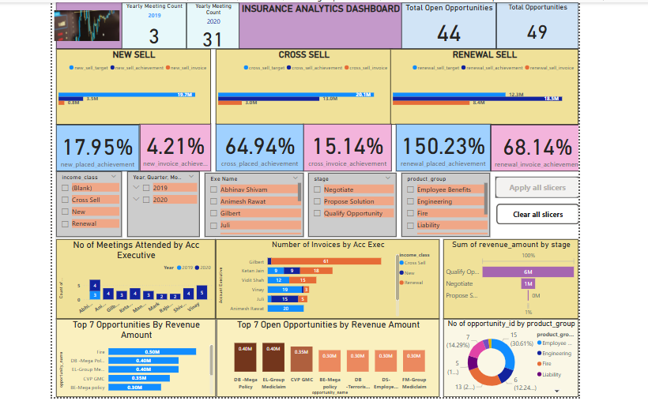
Power BI DashBoard

Slide 10
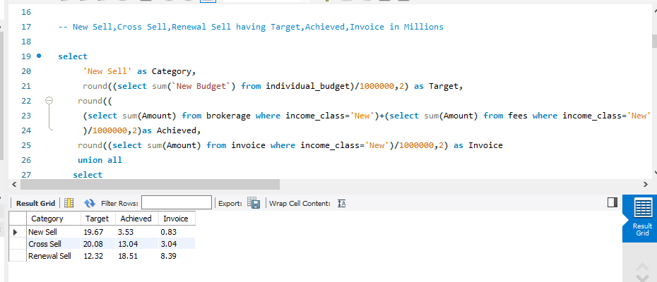
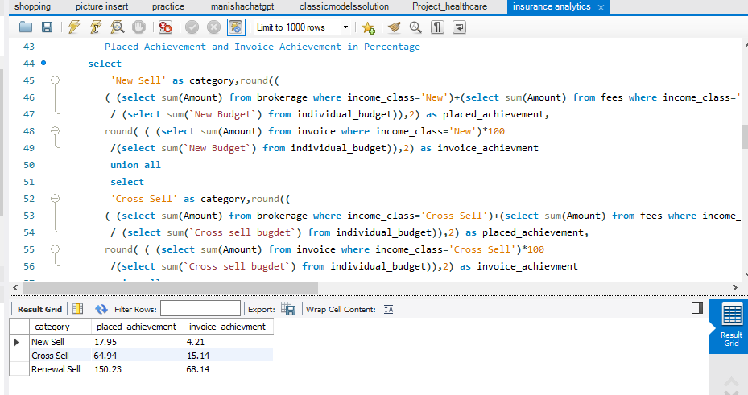
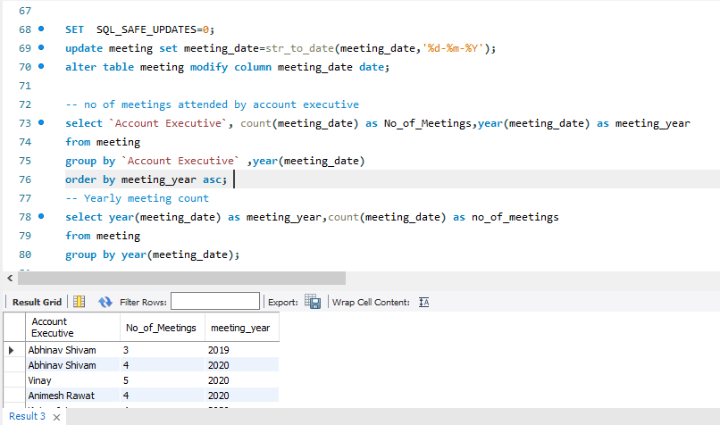
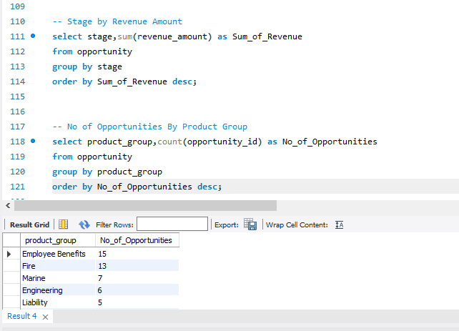
SQL QUERIES

Slide 11
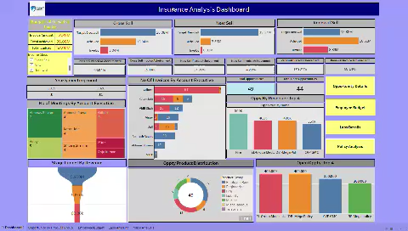
Tableau Dashboard

Slide 12

Target Demographic
Increase Sales Efficiency
Boost Opportunity Conversion
Optimize resource allocation based on real-time performance insights
Identify and act on high-value deals through improved funnel visibility.
Improve Invoice Realization Rate
Enhance Decision-Making
Close the gap between placed and invoiced revenue, especially in New Sell
Empower stakeholders with data-backed insights for faster actions

Slide 13
Challenges Faced during Project
1)Data Size:Difficulty in understanding the data due to the data spread in multiple files.
2) Excel: There are no KPI cards available in Excel,so need to made manually.
Focus mode unavailable for each visual in dashboard which lead to enlarge the size for visuals
and dashboard simultaneously which resulted in screen fit issue of dashboard
3) SQL : Due to complexity of data , runtime of queries was comaparatively long to run complex queries.
Unable to visualize the queries into charts.
4)PowerBI : Slow performance of dashboard due to large data set.
Hence, use of “apply all” “remove all” buttons is done and cross filtering is kept off.
5)Tableau : Limited charts features available for free version.
Increasing number of sheets due to “1 sheet 1 visual “ feature of tableau.

Slide 14
Thank You

